Slide 1
Higher Education Accelerator Common Canvas & Model Apps and Higher Education Portal
Packaging & Layering
Dynamics 365 Higher Ed Portal
PowerApps Portal
Dynamics 365 Higher Education Accelerator Canvas Model Apps
Dynamics 365 Higher Education Accelerator
Education Accelerator Connection Roles
Education Accelerator Common
Microsoft Dataverse
Higher Education Specific Solutions
Existing Microsoft Business Applications Solutions

Slide 2
Education Accelerator Common -> Primary Entities
Entity Name
Academic Period
Academic Period Detail
Academic Subject
Achievements
Accomplishment
Area of Interest
Area of Study
Bell Schedule
Bell Schedule Time
Certification
Certification Process
Certification Requirement
Dynamics 365 Higher Ed Portal
PowerApps Portal
Dynamics 365 Higher Education Accelerator Canvas Model Apps
Dynamics 365 Higher Education Accelerator
Education Accelerator Connection Roles
Education Accelerator Common
CDM Common

Slide 3
Education Accelerator Common -> Primary Entities (continued)
Entity Name
Course
Course History
Course Section
Credential
Education Level
External System
External System Identifier
Extra Curricular Activity
Extra Curricular Participant
Internship
Internship Applicant
Previous Education
Program
Program Level
Dynamics 365 Higher Ed Portal
PowerApps Portal
Dynamics 365 Higher Education Accelerator Canvas Model Apps
Dynamics 365 Higher Education Accelerator
Education Accelerator Connection Roles
Education Accelerator Common
CDM Common

Slide 4
Education Accelerator Common -> Primary Entities (continued)
Entity Name
Program Requirement
Program Version
Program Version Detail
Recommended Student Resource
Registration Status
Scholarship
Scholarship Applicant
School Calendar
School Calendar Date
Student Program Type
Student Resource
Student Status
Test Score
Test Type
Dynamics 365 Higher Ed Portal
PowerApps Portal
Dynamics 365 Higher Education Accelerator Canvas Model Apps
Dynamics 365 Higher Education Accelerator
Education Accelerator Connection Roles
Education Accelerator Common
CDM Common

Slide 5
Education Accelerator Common -> Enriched Entities
Dynamics 365 Higher Ed Portal
PowerApps Portal
Dynamics 365 Higher Education Accelerator Canvas Model Apps
Entity Name | Source
Account | CDM Common
Address | CDM Common
Appointment | CDM Common
Connection | CDM Common
Contact | CDM Common
Task | CDM Common
User | CDM Common
Dynamics 365 Higher Education Accelerator
Education Accelerator Connection Roles
Education Accelerator Common
CDM Common

Slide 6
Education Accelerator Connection Roles -> Primary Connection Roles
Connection Roles
Adjunct
Administrator
Advisor
Affiliate
Aide
Alumni
Assistant
Chair
Coach
Doctor
Faculty
Guardian
Instructor
IT Admin
Dynamics 365 Higher Ed Portal
PowerApps Portal
Dynamics 365 Higher Education Accelerator Canvas Model Apps
Dynamics 365 Higher Education Accelerator
Education Accelerator Connection Roles
Education Accelerator Common
CDM Common

Slide 7
Education Accelerator Connection Roles -> Primary Connection Roles
Connection Roles
Lecturer
Nurse
Occupational Therapist
Office Staff
Other
Paraprofessional
Parent
Physical Therapist
Principal
Proctor
Professor
Relative
Researcher
Special Services
Dynamics 365 Higher Ed Portal
PowerApps Portal
Dynamics 365 Higher Education Accelerator Canvas Model Apps
Dynamics 365 Higher Education Accelerator
Education Accelerator Connection Roles
Education Accelerator Common
CDM Common

Slide 8
Education Accelerator Connection Roles -> Primary Connection Roles
Connection Roles
Speech
Staff
Student
Substitute
Teacher
Teacher Assistant
Vision
Dynamics 365 Higher Ed Portal
PowerApps Portal
Dynamics 365 Higher Education Accelerator Canvas Model Apps
Dynamics 365 Higher Education Accelerator
Education Accelerator Connection Roles
Education Accelerator Common
CDM Common

Slide 9
Dynamics 365 Higher Education Accelerator -> Primary Entities
Dynamics 365 Higher Ed Portal
PowerApps Portal
Dynamics 365 Higher Education Accelerator Canvas Model Apps
Entity Name
Grant
Grant Applicant
Dynamics 365 Higher Education Accelerator
Education Accelerator Connection Roles
Education Accelerator Common
CDM Common

Slide 10
Dynamics 365 Higher Education Accelerator -> Enriched Entities
Entity Name | Source
Academic Period | Education Accelerator Common
Academic Period Detail | Education Accelerator Common
Accomplishment | Education Accelerator Common
Account | CDM Common
Address | CDM Common
Area of Interest | Education Accelerator Common
Area of Study | Education Accelerator Common
Contact | CDM Common
Course | Education Accelerator Common
Course History | Education Accelerator Common
Course Section | Education Accelerator Common
Education Level | Education Accelerator Common
Extra Curricular Activity | Education Accelerator Common
Extra Curricular Participant | Education Accelerator Common
Dynamics 365 Higher Ed Portal
PowerApps Portal
Dynamics 365 Higher Education Accelerator Canvas Model Apps
Dynamics 365 Higher Education Accelerator
Education Accelerator Connection Roles
Education Accelerator Common
CDM Common

Slide 11
Dynamics 365 Higher Education Accelerator -> Enriched Entities
Entity Name | Source
Internship | Education Accelerator Common
Internship Applicant | Education Accelerator Common
Previous Education | Education Accelerator Common
Program | Education Accelerator Common
Program Level | Education Accelerator Common
Program Version | Education Accelerator Common
Program Version Detail | Education Accelerator Common
Recommended Student Resource | Education Accelerator Common
Registration Status | Education Accelerator Common
School Calendar | Education Accelerator Common
Scholarship | Education Accelerator Common
Scholarship Applicant | Education Accelerator Common
Student Program Type | Education Accelerator Common
Student Status | Education Accelerator Common
Dynamics 365 Higher Ed Portal
PowerApps Portal
Dynamics 365 Higher Education Accelerator Canvas Model Apps
Dynamics 365 Higher Education Accelerator
Education Accelerator Connection Roles
Education Accelerator Common
CDM Common

Slide 12
Dynamics 365 Higher Education Accelerator -> Enriched Entities
Entity Name | Source
Task | Common CDM
Test Score | Education Accelerator Common
Test Type | Education Accelerator Common
User | Common CDM
Dynamics 365 Higher Ed Portal
PowerApps Portal
Dynamics 365 Higher Education Accelerator Canvas Model Apps
Dynamics 365 Higher Education Accelerator
Education Accelerator Connection Roles
Education Accelerator Common
CDM Common

Slide 13
Dynamics 365 Higher Education Accelerator Common Canvas Model Apps -> Apps
Dynamics 365 Higher Ed Portal
App Name | Type
Higher Ed | Model-Driven
PowerApps Portal
Dynamics 365 Higher Education Accelerator Canvas Model Apps
Dynamics 365 Higher Education Accelerator
Education Accelerator Connection Roles
Education Accelerator Common
CDM Common

Slide 14
Dynamics 365 Higher Ed Portal -> Enriched Entities
Entity Name | Source
Account | Common CDM
Appointment | Common CDM
Achievement | Education Accelerator Common
Contact | Common CDM
Course | Education Accelerator Common
Course History | Education Accelerator Common
Table Permission | Dynamics 365 Portal
Extra Curricular Activity | Education Accelerator Common
Grant | Higher Education Accelerator Common
Grant Applicant | Higher Education Accelerator Common
Internship | Education Accelerator Common
Internship Applicant | Education Accelerator Common
Dynamics 365 Higher Ed Portal
PowerApps Portal
Dynamics 365 Higher Education Accelerator Canvas Model Apps
Dynamics 365 Higher Education Accelerator
Education Accelerator Connection Roles
Education Accelerator Common
CDM Common

Slide 15
Dynamics 365 Higher Ed Portal -> Enriched Entities (continued)
Entity Name | Source
Program Requirement | Education Accelerator Common
Scholarship | Education Accelerator Common
Scholarship Applicant | Education Accelerator Common
Student Resource | Education Accelerator Common
Task | Common CDM
Dynamics 365 Higher Ed Portal
PowerApps Portal
Dynamics 365 Higher Education Accelerator Canvas Model Apps
Dynamics 365 Higher Education Accelerator
Education Accelerator Connection Roles
Education Accelerator Common
CDM Common

Slide 16
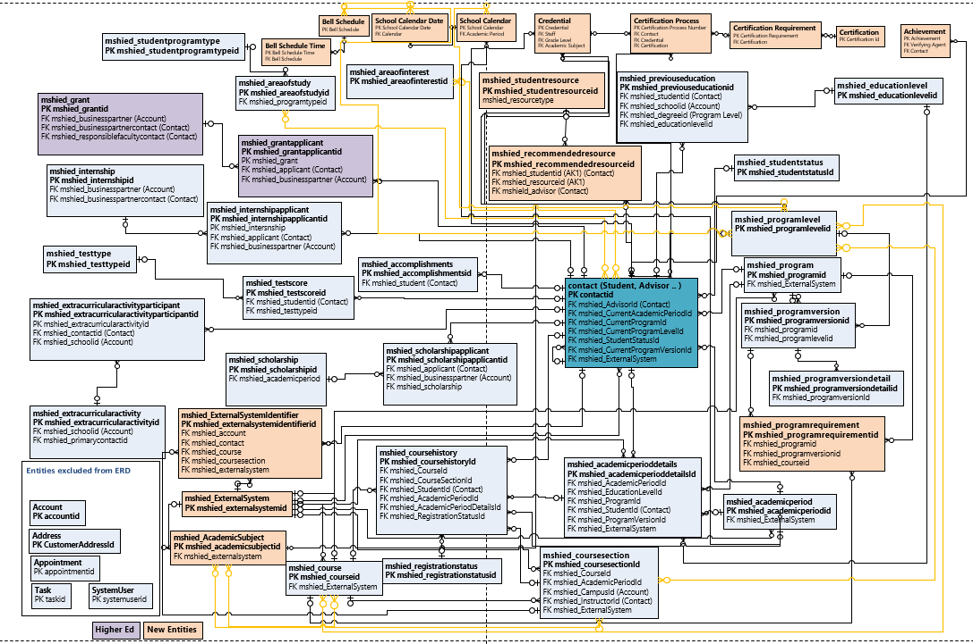
ERD : Education Accelerator Common

Slide 17
Connection Roles From Account to Contact
Adjunct
Administrator
Advisor
Affiliate
Aide
Alumni
Assistant
Chair
Coach
Doctor
Faculty
Guardian
Instructor
IT Admin
Lecturer
Nurse
Occupational Therapist
Office Staff
Other
Paraprofessional
Parent
Physical Therapist
Principal
Proctor
Professor
Relative
Researcher
Special services
Speech
Staff
Student
Substitute
Teacher
Teacher Assistant
Vision
Connection Roles From Course and Course History to Contact
Adjunct
Administrator
Advisor
Affiliate
Aide
Assistant
Course
Coach
Instructor
Lecturer
Occupational Therapist
Paraprofessional
Physical Therapist
Principal
Proctor
Professor
Special services
Speech
Student
Substitute
Teacher
Teacher Assistant
Connection Roles
Connection Roles From Contact to Contact
Administrator
Advisor
Aide
Child
Doctor
Guardian
Other
Parent
Relative

